Slide 1
Meeting - 20/12/21
Tobias Dieler and Gautam Vyas

Slide 2
Updates
Main task: Investigating the baseline regression from last time
Looking at non-linearities in the relationship between stock performance, hospital beds and GDP per capita
Looking at Eikon/Compustat for firm-level data
Motivation: rather than doing a cross-country study, we could instead look at profitability of firms in different regions of a country and regress this on preparedness of firms within these regions
Would hopefully lend itself to better identification (less confounding factors between regions of a country)
(issues with my accessibility/lagging remote desktop limited progress on this task)

Slide 3
Investigating the Baseline Regression

Slide 4
Reminder of last time:

Slide 5
Negative relationship between hospital beds and stock performance

Slide 6
But:
One could imagine a relationship between stock performance and hospital beds that varies based on the level of income in a country
To investigate, I divide the sample into five subsamples, by cumulative quantile of the GDP/capita distribution
1st subsample is poorest 20%, 2nd is poorest 40%, etc.
The following graphs show the relationship between stock performance and hospital beds, for each subsample.

Slide 12
(putting the diagrams together)

Slide 13
Interpretation
Suggestive evidence that increasing hospital beds improves stock performance in the poorest countries, but this effect falls and eventually reverses as GDP/capita increases.
To me, this seems plausible (though I wouldn’t expect the effect to reverse; maybe just to decrease as countries get richer). Any thoughts?
To test this more rigorously, I conducted another regression, including an interaction term to capture nonlinearities in the effects of hospital beds and GDP/capita.

Slide 14
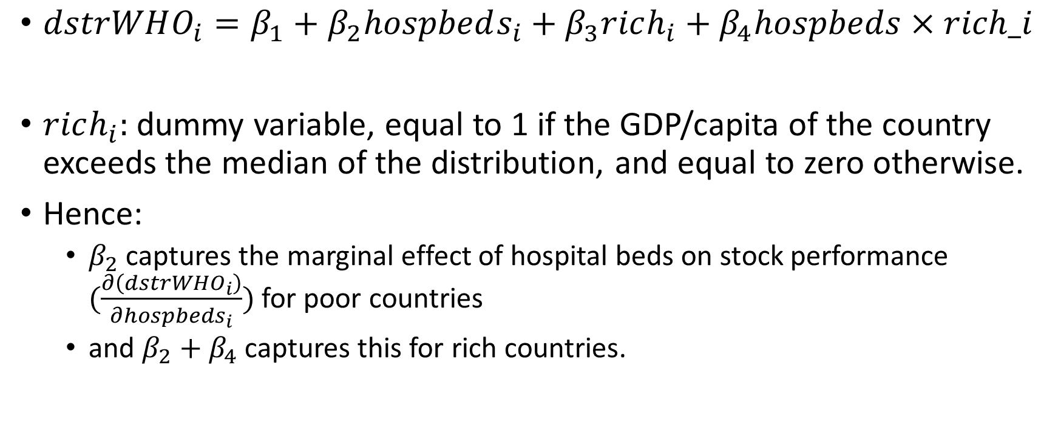
New model
$dstrWHO_{i}=β_{1}+β_{2}hospbeds_{i}+β_{3}rich_{i}+β_{4}hospbeds×rich_i$
$rich_{i}:$ dummy variable, equal to 1 if the GDP/capita of the country exceeds the median of the distribution, and equal to zero otherwise.
Hence:
$β_{2}$ captures the marginal effect of hospital beds on stock performance $(\frac{∂\left(dstrWHO_{i}\right)}{∂hospbeds_{i}})$ for poor countries
and $β_{2}+β_{4}$ captures this for rich countries.

Slide 16
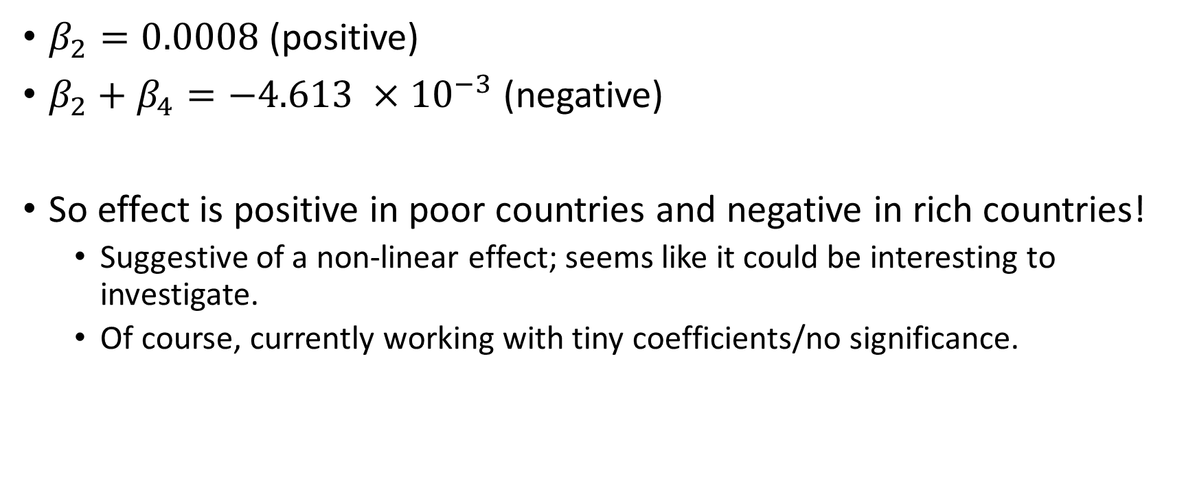
Interpretation
$β_{2}=0.0008$ (positive)
$β_{2}+β_{4}=−4.613 ×{10}^{−3}$ (negative)
So effect is positive in poor countries and negative in rich countries!
Suggestive of a non-linear effect; seems like it could be interesting to investigate.
Of course, currently working with tiny coefficients/no significance.

Slide 17
Firm-Level Data

Slide 18

Profitability

Slide 19
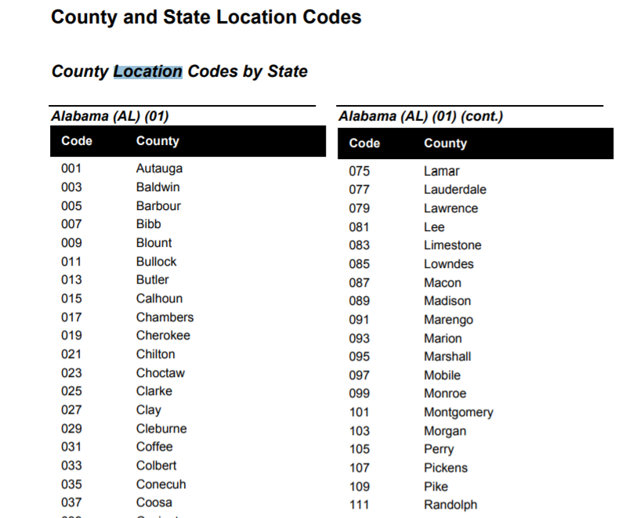
Location

Slide 20
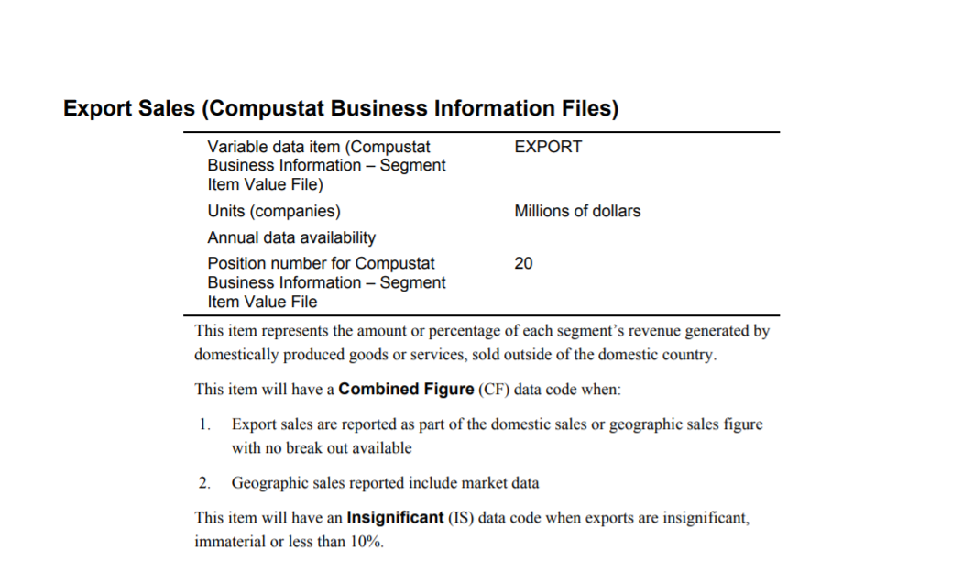
Exports

